Slide 1
Chapter 4
Digital Transmission

Slide 2
DIGITAL-TO-DIGITAL CONVERSION
Digital data by using digital signals.
The conversion involves three techniques:
  line coding
  block coding
  scrambling

Slide 3
Line Coding
Convert digital data to digital signal
Converting a string of 1’s and 0’s (digital data) into a sequence of signals that denote the 1’s and 0’s.
For example a high voltage level (+V) could represent a “1” and a low voltage level (0 or -V) could represent a “0”.

Slide 4

Line coding and decoding

Slide 5
Mapping Data symbols onto Signal levels
A data symbol (or element) can consist of a number of data bits:
  1 , 0 or
  11, 10, 01, ……
A data symbol can be coded into a single signal element or multiple signal elements
  1 -> +V, 0 -> -V
  1 -> +V and -V, 0 -> -V and +V
The ratio ‘r’ is the number of data elements carried by a signal elementS

Slide 6

Signal element versus data element

Slide 7
Relationship between data rate and signal rate
The data rate (bit rate) defines the number of bits sent per sec – bps
The signal rate (baud) is the number of signal elements sent in a second.
Goal is to increase the data rate whilst reducing the baud rate.

Slide 8
Data rate and Baud rate
The baud or signal rate can be expressed as:
S = c x N x 1/r bauds
where N is data rate – 100 kbps
c is the case factor (worst, best & avg.) - 1/2
r is the ratio between data element & signal element - one data element is encoded as one signal element ( r = 1)

Slide 9
Although the actual bandwidth of a digital signal is infinite, the effective bandwidth is finite.

Slide 10
choosing a good signal element -line encoding
Baseline wandering- long string of 0s and 1s can cause a base line drift
A good line encoding scheme will prevent long runs of fixed amplitude.
DC components - when the voltage level remains constant for long periods of time, there is an increase in the low frequencies of the signal.
Self synchronization - the clocks at the sender and the receiver must have the same bit interval.
Error detection - errors occur during transmission due to line impairments.
Noise and interference - the signal cannot be corrupted, it is stronger than error detection.
Complexity - the more robust and resilient the code, the more complex it is to implement

Slide 11

Figure 4.3 Effect of lack of synchronization

Slide 12

Figure 4.4 Line coding schemes

Slide 13
Unipolar
All signal levels are on one side of the time axis - either above or below
NRZ - Non Return to Zero scheme is an example of this code. The signal level does not return to zero during a symbol transmission.
Scheme is prone to baseline wandering and DC components. It has no synchronization or any error detection. It is simple but costly in power consumption.

Slide 14

Figure 4.5 Unipolar NRZ scheme
4.<number>

Slide 15
Polar - NRZ
The voltages are on both sides of the time axis.
Polar NRZ scheme can be implemented with two voltages. E.g. +V for 1 and -V for 0.
There are two versions:
  NZR - Level (NRZ-L) - positive voltage for one symbol and negative for the other
  NRZ - Inversion (NRZ-I) - the change or lack of change in polarity determines the value of a symbol. E.g. a “1” symbol inverts the polarity a “0” does not.

Slide 16

Polar NRZ-L and NRZ-I schemes
In NRZ-L the level of the voltage determines the value of the bit.
In NRZ-I the inversion or the lack of inversion determines the value of the bit.

Slide 17
NRZ-L and NRZ-I both have an average signal rate of N/2 Bd.
NRZ-L and NRZ-I both have a DC component problem and baseline wandering, it is worse for NRZ-L.
Both have no self synchronization &no error detection.
Both are relatively simple to implement.

Slide 18
Example
A system is using NRZ-I to transfer 1-Mbps data. What are the average signal rate and minimum bandwidth?
Solution
The average signal rate is S= c x N x R = 1/2 x N x 1 = 500 kbaud. The minimum bandwidth for this average baud rate is Bmin = S = 500 kHz.
Note c = 1/2 for the avg. case as worst case is 1 and best case is 0

Slide 19

Polar RZ scheme

Slide 20
Polar - RZ
The Return to Zero (RZ) scheme uses three voltage values. +, 0, -.
Each symbol has a transition in the middle. Either from high to zero or from low to zero.
This scheme has more signal transitions (two per symbol) and therefore requires a wider bandwidth.
No DC components or baseline wandering.
Self synchronization - transition indicates symbol value.
More complex as it uses three voltage level. It has no error detection capability.

Slide 21
Polar - Biphase: Manchester and Differential Manchester
Manchester coding consists of combining the NRZ-L and RZ schemes.
  Every symbol has a level transition in the middle: from high to low or low to high. Uses only two voltage levels.
Differential Manchester coding consists of combining the NRZ-I and RZ schemes.
  Every symbol has a level transition in the middle. But the level at the beginning of the symbol is determined by the symbol value. One symbol causes a level change the other does not.

Slide 22

Polar biphase: Manchester and differential Manchester schemes
In Manchester and differential Manchester encoding, the transition at the middle of the bit is used for synchronization.

Slide 23
The minimum bandwidth of Manchester and differential Manchester is 2 times that of NRZ.
The is no DC component and no baseline wandering.
None of these codes has error detection.

Slide 24
Bipolar - AMI and Pseudoternary
Code uses 3 voltage levels: - +, 0, -, to represent the symbols (note not transitions to zero as in RZ).
Voltage level for one symbol is at “0” and the other alternates between + & -.
Bipolar Alternate Mark Inversion (AMI) - the “0” symbol is represented by zero voltage and the “1” symbol alternates between +V and -V.
Pseudoternary is the reverse of AMI.

Slide 25

Bipolar schemes: AMI and pseudoternary

Slide 26
Bipolar C/Cs
It is a better alternative to NRZ.
Has no DC component or baseline wandering.
Has no self synchronization because long runs of “0”s results in no signal transitions.
No error detection.

Slide 27
01010101
0 | 1 | 0 | 1 | 0 | 1 | 0 | 1
Unipolar
NRZ-L
NRZ-I
POLAR –RZ
Manchester
Differential Manchester
AMI
Pseudoternary

Slide 28
Multilevel Schemes
In these schemes we increase the number of data bits per symbol thereby increasing the bit rate.
binary data → 2 types of data element a 1 or a 0.
2 data elements → pattern of “m” elements to create “2^{m}” symbols.
L signal levels→ “n” signal elements to create L^{n} signal elements.
➔ 2^{m} symbols and L^{n} signals.
If 2^{m} > L^{n} →No have enough signals.
If 2^{m} = L^{n} → an exact mapping of one symbol on one signal.
If 2^{m} < L^{n} → more signals than symbols
  choose the signals that are more distinct to represent the symbols
  better noise immunity and error detection -> some signals are not valid.

Slide 29
Representing Multilevel Codes
We use the notation mBnL,
  where m is the length of the binary pattern,
  B represents binary data,
  n represents the length of the signal pattern,
  L the number of levels.
    B binary, L =2,
    T for ternary, L =3
    Q for quaternary, L =4

Slide 30
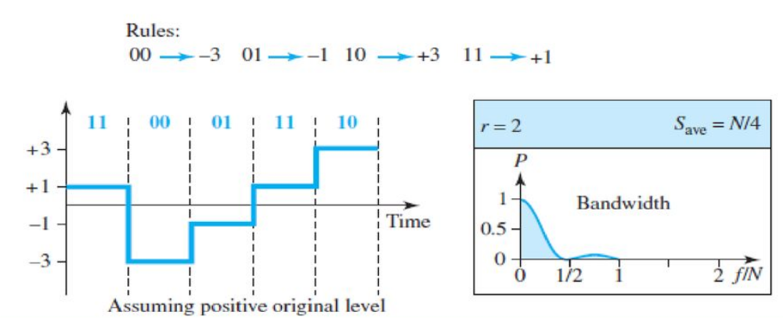
Multilevel: 2B1Q scheme
No redundancy and DC component is present.

Slide 31

Figure 4.11 Multilevel: 8B6T scheme
4.<number>

Slide 32
Multilevel using multiple channels
Split the signal transmission up and distribute it over several links.
The separate segments are transmitted simultaneously.
reduces the signaling rate per link -> lower bandwidth.
requires all bits for a code to be stored.
xD: means that we use ‘x’ links
YYYz: We use ‘z’ levels of modulation where YYY represents the type of modulation (e.g. pulse ampl. mod. PAM).
Codes are represented as: xD-YYYz
4.<number>

Slide 33

Figure 4.12 Multilevel: 4D-PAM5 scheme
4.<number>

Slide 34
Multitransition Coding
Synchronization requirements → force transitions.
Results in very high bandwidth requirements -> more transitions than are bits (e.g. mid bit transition with inversion).
Codes can be created that are differential at the bit level forcing transitions at bit boundaries. This results in a bandwidth requirement that is equivalent to the bit rate.
In some instances, the bandwidth requirement may even be lower, due to repetitive patterns resulting in a periodic signal.
4.<number>

Slide 35

Figure 4.13 Multitransition: MLT-3 scheme
4.<number>

Slide 36
MLT-3
Signal rate is same as NRZ-I
But because of the resulting bit pattern, we have a periodic signal for worst case bit pattern: 1111
This can be approximated as an analog signal a frequency 1/4 the bit rate!
4.<number>

Slide 37


Table 4.1 Summary of line coding schemes
4.<number>

Slide 38
Block Coding
For error detection, we add redundancy, i.e., extra bits to the data bits.
Synchronization also requires redundancy - transitions are important in the signal flow and must occur frequently.
Block coding is done in three steps: division, substitution and combination.
It is distinguished from multilevel coding by use of the slash - mB/nB.
The resulting bit stream prevents certain bit combinations that when used with line encoding would result in DC components or poor sync. quality.
4.<number>

Slide 39

Figure 4.14 Block coding concept
4.<number>

Slide 40

Figure 4.15 Using block coding 4B/5B with NRZ-I line coding scheme
4.<number>

Slide 41
Redundancy
A 4 bit data word can have 24 combinations.
A 5 bit word can have 25=32 combinations.
We therefore have 32 - 26 = 16 extra words.
Some of the extra words are used for control/signalling purposes.
4.<number>

Slide 42


Table 4.2 4B/5B mapping codes
4.<number>

Slide 43

Figure 4.17 8B/10B block encoding
The 8B/10B block code adds more redundant bits
choose code words that would prevent a long run of a voltage level that would cause DC components.
Disparity controller keeps track of excess Os over Is
4.<number>

Slide 44
Scrambling
The best code => does not increase the bandwidth for synchronization and has no DC components.
Scrambling is a technique used to create a sequence of bits that has the required c/c’s for transmission - self clocking, no low frequencies, no wide bandwidth.
It is implemented at the same time as encoding
It replaces ‘unfriendly’ runs of bits with a violation code that is easy to recognize and removes the unfriendly c/c.
4.<number>

Slide 45

Figure 4.18 AMI used with scrambling
4.<number>

Slide 46

Two cases of B8ZS (Bipolar with S-zero substitution (BSZS))
scrambling technique
B8ZS substitutes eight consecutive zeros with 000VB0VB.
The V stands for violation, it violates the line encoding rule
B stands for bipolar, it implements the bipolar line encoding rule
4.<number>

Slide 47

Figure 4.20 Different situations in HDB3 scrambling technique
HDB3 substitutes four consecutive zeros with 000V or B00V depending on the number of nonzero pulses after the last substitution.
If # of non zero pulses is even the substitution is B00V to make total # of non zero pulse even.
If # of non zero pulses is odd the substitution is 000V to make total # of non zero pulses even.
4.<number>

